Slide 1
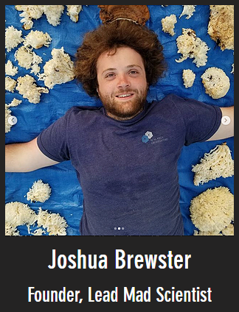


Sissejuhatus psühhofüsioloogia rakendustesse
Muud mõõdikud
Richard Naar
Kursuse arendamist toetas Haridus- ja noorteameti IT-akadeemia
Notes:
https://www.hegalpha.com/

Slide 2
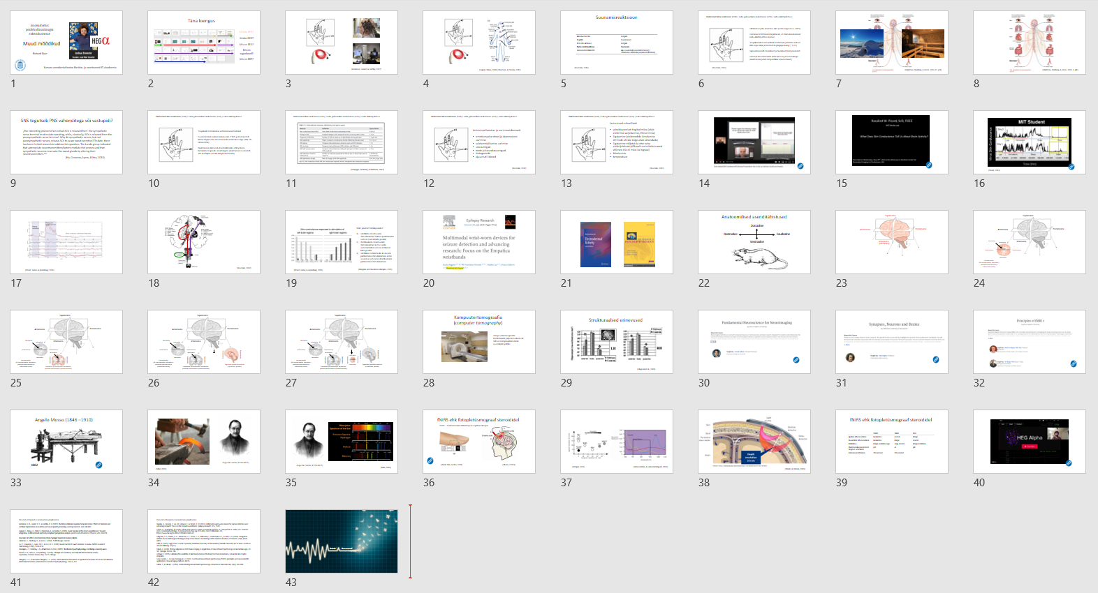
Täna loengus
EDR
Asenditähistused
fNIRS

Slide 3
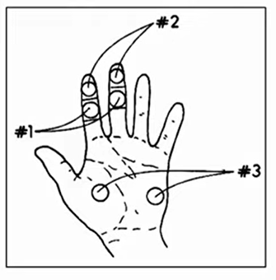
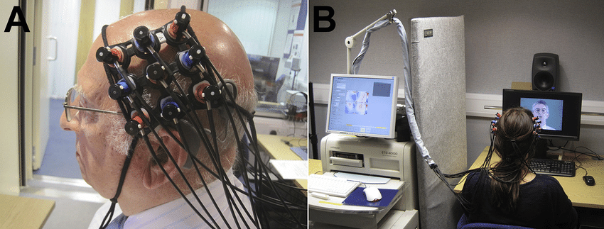
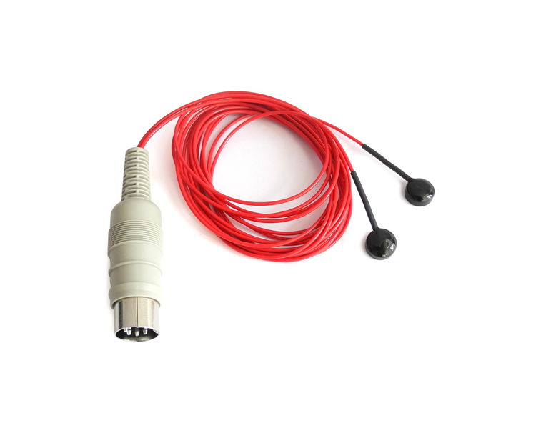
(Anderson, Lazard, & Hartley, 2017)
Notes:
Anderson, C. A., Lazard, D. S., & Hartley, D. E. (2017). Plasticity in bilateral superior temporal cortex: Effects of deafness and cochlear implantation on auditory and visual speech processing. Hearing research, 343, 138-149.
http://www.psychlab.com/SC_explained.html
https://www.youtube.com/watch?v=-KupdgJERng

Slide 4
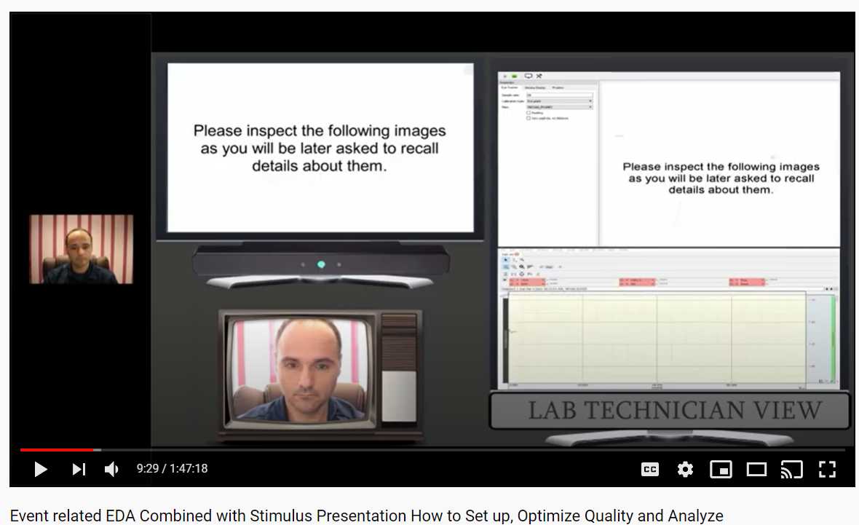

Notes:
https://www.youtube.com/watch?v=TROU-5j2H6c

Slide 5
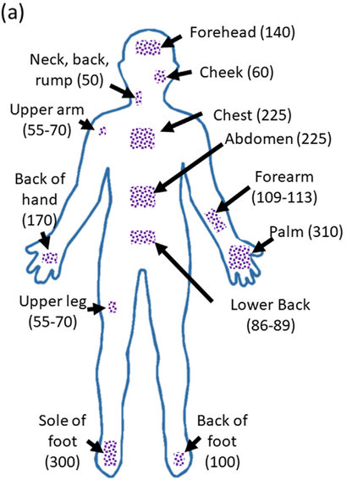
(Legner, Kalwa, Patel, Chesmore, & Pandey, 2019)
Notes:
Legner, C., Kalwa, U., Patel, V., Chesmore, A., & Pandey, S. (2019). Sweat sensing in the smart wearables era: Towards integrative, multifunctional and body-compliant perspiration analysis. Sensors and Actuators A: Physical, 296, 200-221.

Slide 6
Suunamisreaktsioon
Absoluutne lävi | Langeb
Pupillid | Suurenevad
EEG alfa aktiivsus | Langeb
Naha elektrijuhtivus | Suureneb
Veresoonte läbimõõt | Ajus suureneb (vasodilatatsioon) / Jäsemetes väheneb (vasokonstriktsioon)
(Boucsein, 2012)
Notes:
Boucsein, W. (2012). Electrodermal activity. Springer Science & Business Media.

Slide 7
Elektrodermiline reaktsioon (EDR) / naha galvaaniline reakatsioon (GSR) / naha elektrijuhtivus
Mõõdetud juba enam kui 140 aastat (Vigouroux, 1879)
Esimesed mõõtmised kirjeldavad, et stiimuli esitamisel naha elektrijuhtivus kasvas
Tüüpilisel eksosomaatilisel mõõtmisel juhitakse nahast läbi väga väike ja konstantse pingega laeng (~ 0,5V)
Signaal koosneb toonilisest ja faasilisest komponendist
Seostub emotsionaalse intensiivsuse ja motoorikaga (reaktsiooni juhib sümpaatiline närvisüsteem)
(Boucsein, 2012)

Slide 8
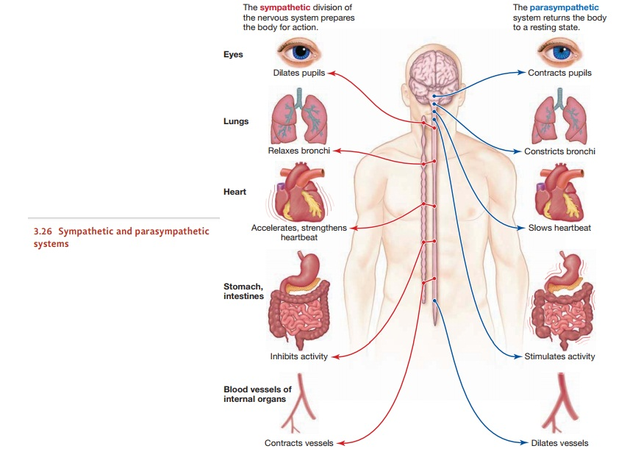
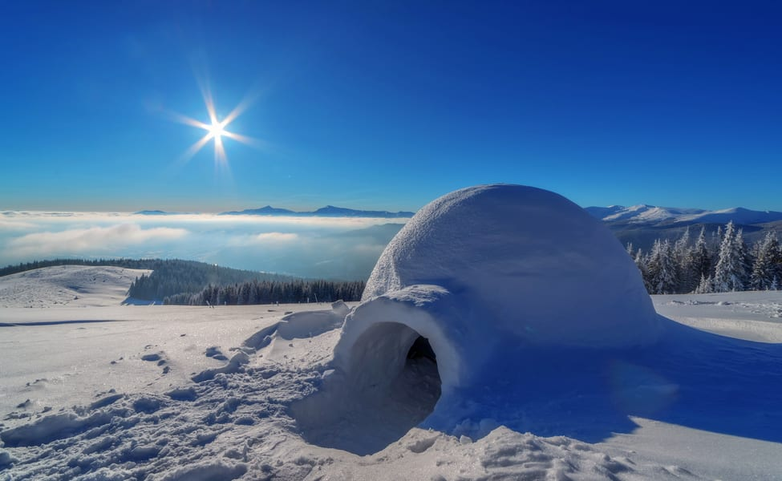
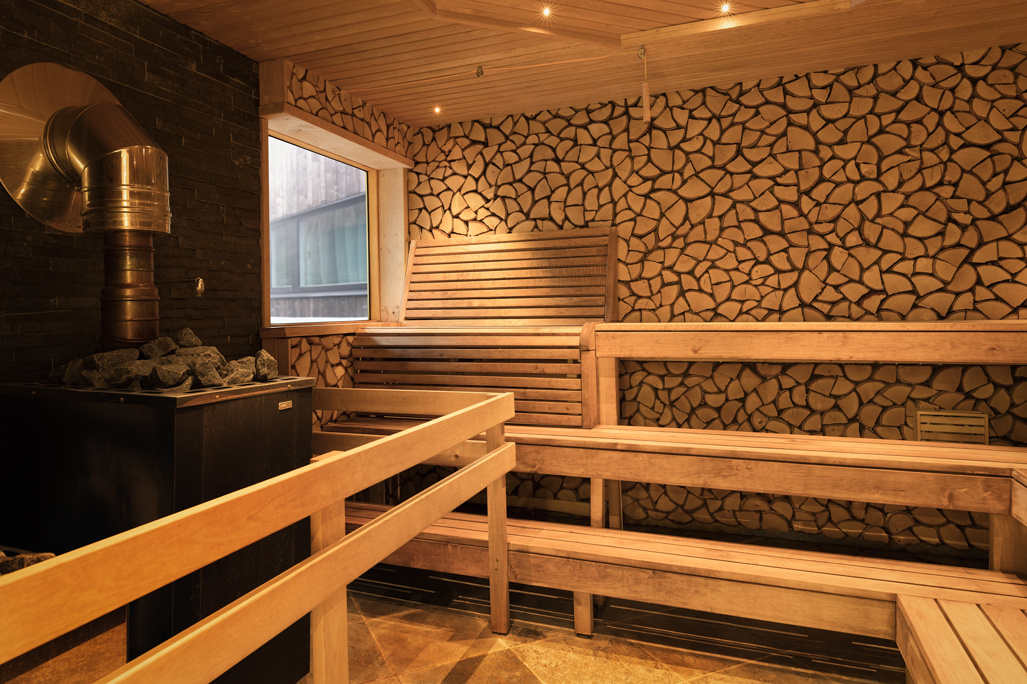
(Gleitman, Reisberg, & Gross, 2003, 12. ptk)

Slide 9
(Gleitman, Reisberg, & Gross, 2003, 3. ptk)

Slide 10
SNS tegutseb PNS vahenditega või vastupidi?
„The interesting phenomenon is that ACh is released from the sympathetic nerve terminal to stimulate sweating, while, classically, ACh is released from the parasympathetic nerve terminal. Why do sympathetic nerves, but not parasympathetic nerves, release ACh to cause sweat secretion? To date, there has been limited research to address this question. The Landis group indicated that appropriate neurotransmitters/factors mediate this process and that sympathetic neurons innervate the sweat glands by altering their neurotransmitters.³⁷“
(Hu, Converse, Lyons, & Hsu, 2018)
Notes:
Hu, Y., Converse, C., Lyons, M. C., & Hsu, W. H. (2018). Neural control of sweat secretion: a review. British Journal of Dermatology, 178(6), 1246-1256.

Slide 11
Elektrodermiline reaktsioon (EDR) / naha galvaaniline reakatsioon (GSR) / naha elektrijuhtivus
Tüüpiliselt mõõdetakse mittedominantsel käel
Suured individuaalsed erinevused (~10% puhul seostub labori tingimustes emotsionaalse intensiivsusega vähe või üldse mitte)
Reaktsiooni olemasolu kontrollimiseks võib paluda katseisikul sügavalt, sisse hingata (reaktsiooni suurendab see kui hiljem natuke hinge kinni hoida)
Notes:
Legner, C., Kalwa, U., Patel, V., Chesmore, A., & Pandey, S. (2019). Sweat sensing in the smart wearables era: Towards integrative, multifunctional and body-compliant perspiration analysis. Sensors and Actuators A: Physical, 296, 200-221.

Slide 12
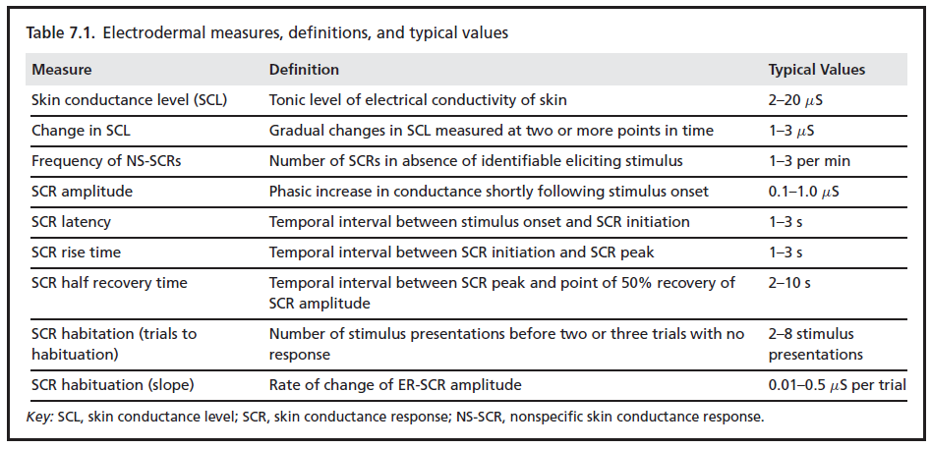
Elektrodermiline reaktsioon (EDR) / naha galvaaniline reakatsioon (GSR) / naha elektrijuhtivus
(Cacioppo, Tassinary, & Berntson, 2007)
Notes:
Cacioppo, J. T., Tassinary, L. G., & Berntson, G. (Eds.). (2007). Handbook of psychophysiology. Cambridge university press.

Slide 13
Elektrodermiline reaktsioon (EDR) / naha galvaaniline reakatsioon (GSR) / naha elektrijuhtivus
Levinuimad kasutus- ja uurimisvaldkonnad:
emotsionaalse stressi ja depressiooni uurimine
valetamiskäitumise uurimine
uneuuringud
toote ja turundusuuringud
biotagasiside
aju-arvuti liidesed
(Boucsein, 2012)
Notes:
Legner, C., Kalwa, U., Patel, V., Chesmore, A., & Pandey, S. (2019). Sweat sensing in the smart wearables era: Towards integrative, multifunctional and body-compliant perspiration analysis. Sensors and Actuators A: Physical, 296, 200-221.
Boucsein, W. (2012). Electrodermal activity. Springer Science & Business Media.

Slide 14
Elektrodermiline reaktsioon (EDR) / naha galvaaniline reakatsioon (GSR) / naha elektrijuhtivus
Levinuimad müraallikad:
vahelduvvoolust tingitud müra (aitab elektriline varjestamine, filtreerimine)
liigutamine (elektroodide kinnitamine sõrmede või käe külge aitab vähendada)
liigutamine mõjutab ka otse naha elektrijuhtivust (sõltuvalt uurimisküsimusest võib see olla nii müra kui signaal)
kõnelemine
temperatuur
(Boucsein, 2012)
Notes:
Legner, C., Kalwa, U., Patel, V., Chesmore, A., & Pandey, S. (2019). Sweat sensing in the smart wearables era: Towards integrative, multifunctional and body-compliant perspiration analysis. Sensors and Actuators A: Physical, 296, 200-221.
Boucsein, W. (2012). Electrodermal activity. Springer Science & Business Media.

Slide 15
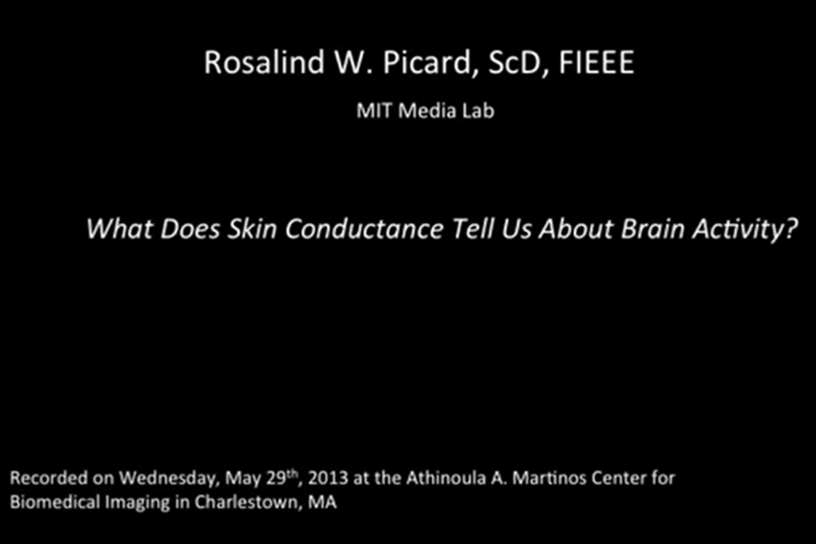
Notes:
https://www.youtube.com/watch?v=nSasaqQV2xg

Slide 16
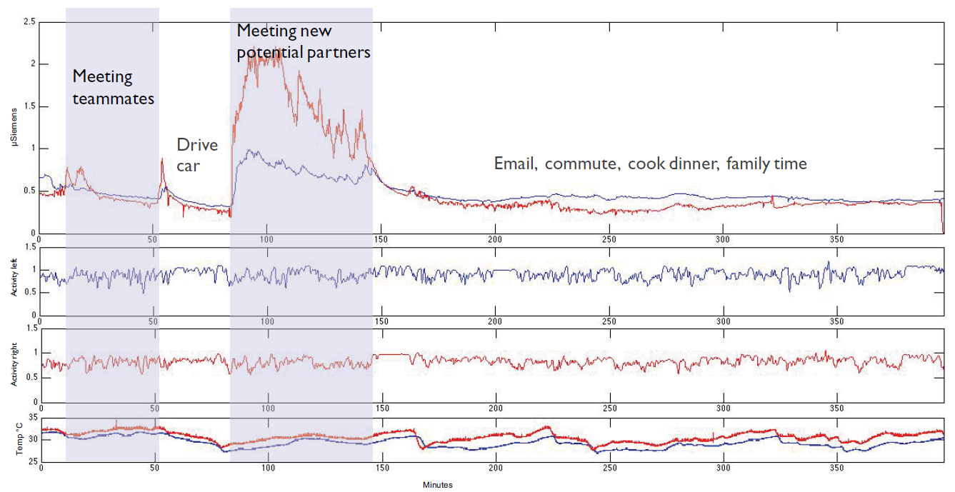
(Picard, Fedor, & Ayzenberg, 2016)
Notes:
Picard, R. W., Fedor, S., & Ayzenberg, Y. (2016). Multiple arousal theory and daily-life electrodermal activity asymmetry. Emotion Review, 8(1), 62-75. Chicago
Figure 2. Five hours of bilateral data including two meetings (shaded). Red = right wrist, blue = left wrist. Top graph = SCL. Middle two graphs =
activity level. Bottom graph = skin temperature. The team meeting has low and mostly symmetric EDA after the “sorry I’m late” entrance peaks.
The high-stakes meeting with top potential partners has higher arousal on both left and right sides, with substantially more right arousal than left.
Symmetry returns as soon as the high-stakes meeting ends.

Slide 17
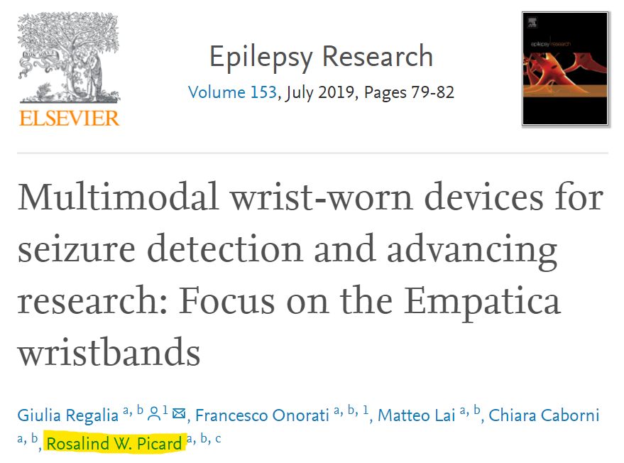
Notes:
Regalia, G., Onorati, F., Lai, M., Caborni, C., & Picard, R. W. (2019). Multimodal wrist-worn devices for seizure detection and advancing research: focus on the Empatica wristbands. Epilepsy research, 153, 79-82.

Slide 18
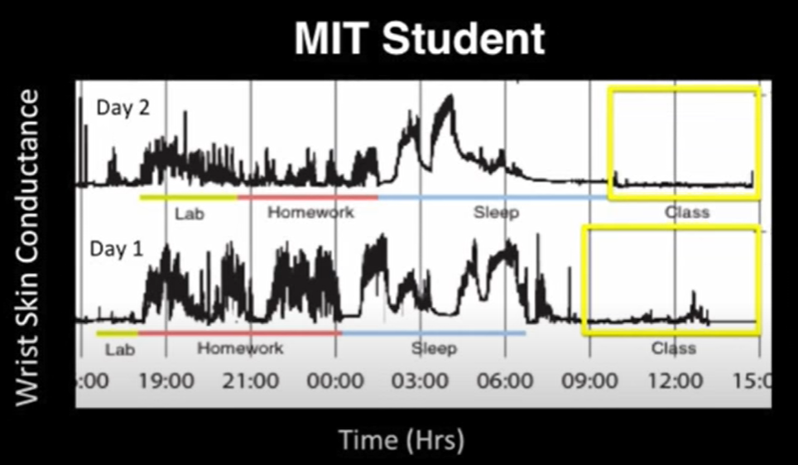
(Picard, 2013)
Notes:
https://www.youtube.com/watch?v=ZCO6o2Vyc2Q

Slide 19
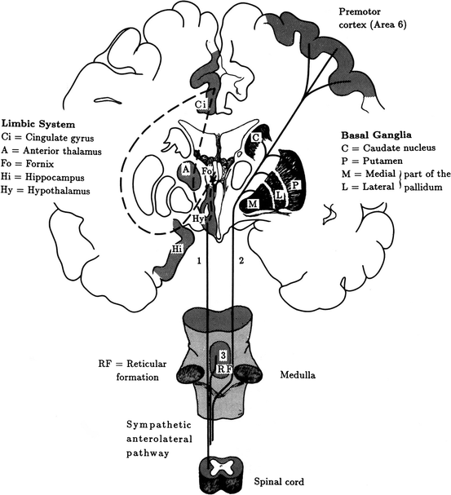
(Boucsein, 2012)
Notes:
Boucsein, W. (2012). Electrodermal activity. Springer Science & Business Media.
Fig. 1.6 Central nervous system elicitation of EDA in humans. 1: ipsilateral influences from the
limbic system via hypothalamic thermoregulatory areas (EDA1); 2: contralateral influences from
premotor cortical and basal ganglia areas (EDA2); 3: reticular influences. Dashed: Connections
within the limbic system (Fig. 1.4, Sect. 1.3.2.2). Adapted from Schliack and Schiffter (1979),
Fig. 1.4c. Copyright 1979 by Springer. Used by permission of the publisher

Slide 20
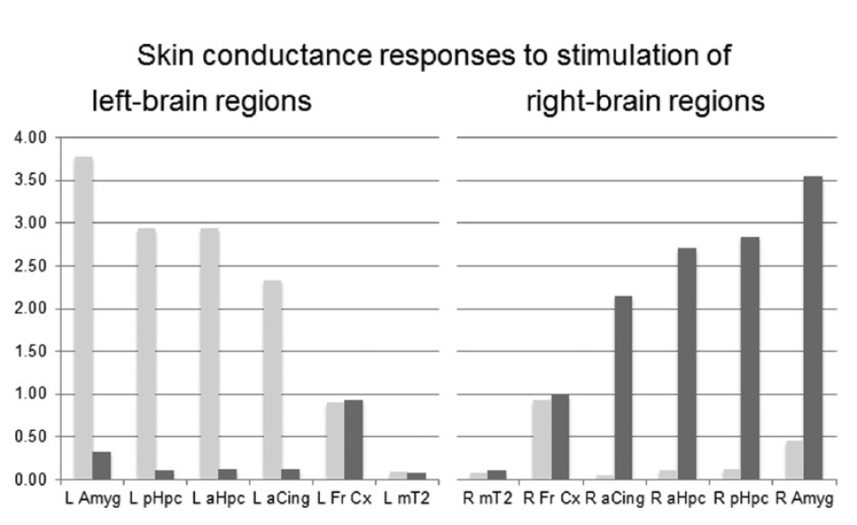
Kolm peamist tähelepanekut:
Limbiliste struktuuride stimuleerimine tekitas ipsilateraalse vastuse (samal keha poolel)
Kortikaalsete struktuuride stimuleerimine kutsus esile sümmeetrilise vastuse mõlemal keha poolel
Limbilise süsteemi alla kuuluvate piirkondade stimuleerimine andis suurema vastuse kui kortikaalsete piirkondade stimuleerimine
(Picard, Fedor, & Ayzenberg, 2016)
(Mangina and Beuzeron-Mangina, 1996)
Notes:
Figure 4 reveals three important findings: (a) Responses to direct stimulation of the eight limbic regions are strong and asymmetric:
The left amygdala, left anterior hippocampus, left posterior hippocampus, and left anterior cingulate gyrus gave strong and statistically
significant EDA responses on the left side of the body and almost no response on the right. Ipsilaterality also held when the limbic
structures on the right side of the brain were directly stimulated. In particular, the amygdalae gave the strongest EDA responses.
(b) Responses to direct stimulation of the four cortical regions were small and symmetric: left and right frontal cortical convexities and
left and right mid cortical regions of the second temporal gyri contributed equally to the left and right palmar EDA. (c) The response from the
limbic regions was significantly stronger than the cortical regions.
Picard, R. W., Fedor, S., & Ayzenberg, Y. (2016). Multiple arousal theory and daily-life electrodermal activity asymmetry. Emotion Review, 8(1), 62-75.
Mangina, C. A., & Beuzeron-Mangina, J. H. (1996). Direct electrical stimulation of specific human brain structures and bilateral electrodermal activity. International Journal of Psychophysiology, 22(1-2), 1-8.

Slide 21
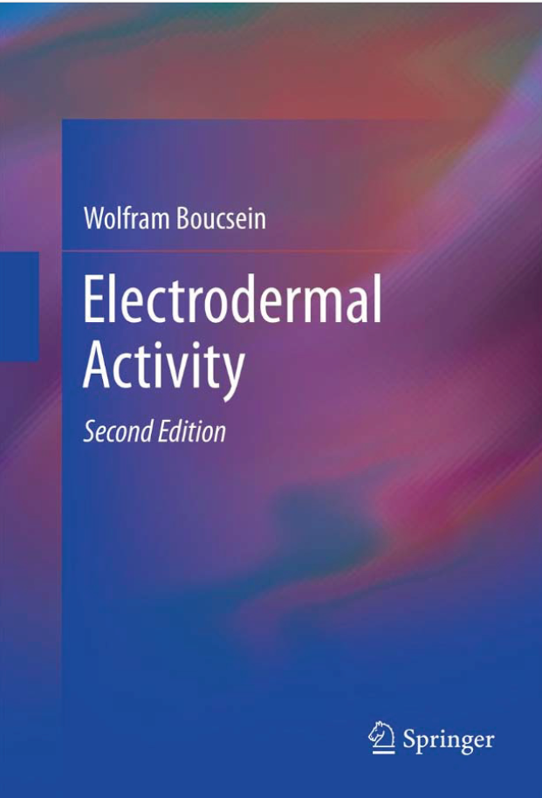

Notes:
Boucsein, W. (2012). Electrodermal activity. Springer Science & Business Media.
Cacioppo, J. T., Tassinary, L. G., & Berntson, G. (Eds.). (2007). Handbook of psychophysiology. Cambridge university press.

Slide 22
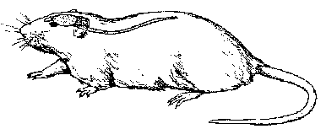
Anatoomilised asenditähistused
Dorsaalne
Rostraalne
Kaudaalne
Ventraalne

Slide 23
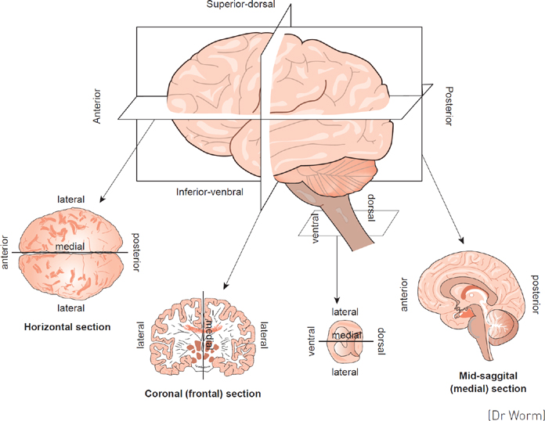
Superioorne
Anterioorne
Posterioorne
Inferioorne
Inferioorne
Notes:
https://www.kaltura.com/index.php/extwidget/preview/partner_id/816122/uiconf_id/44640271/entry_id/0_zgy98rfg/embed/dynamic?
https://sk.sagepub.com/books/essential-psychology/n7.xml
Castro, A., & Sergeant, M. (2010). The human nervous system: functional anatomy. In P. BanyardM. N. Davies, & C. Norman (Eds.), Essential psychology: A concise introduction (pp. 129-149). SAGE Publications Ltd, https://www.doi.org/10.4135/9781446251461.n7

Slide 24
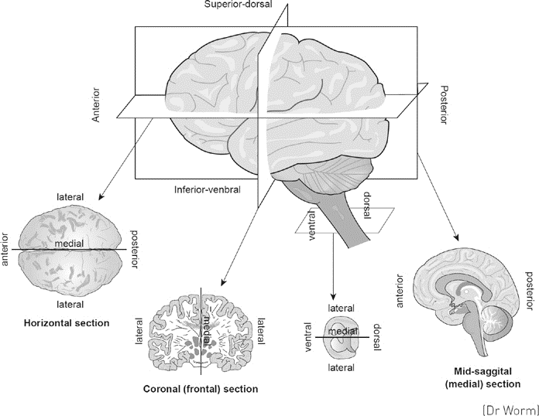
Superioorne
Anterioorne
Posterioorne
Mediaalne
Inferioorne
Lateraalne
Inferioorne
Anterioorne
Posterioorne
Lateraalne
Horisontaalne
(vk transversaalne, aksiaalne –
poolitab superioorseks ja inferoorseks osaks)
Notes:
https://www.kaltura.com/index.php/extwidget/preview/partner_id/816122/uiconf_id/44640271/entry_id/0_zgy98rfg/embed/dynamic?
https://sk.sagepub.com/books/essential-psychology/n7.xml
Castro, A., & Sergeant, M. (2010). The human nervous system: functional anatomy. In P. BanyardM. N. Davies, & C. Norman (Eds.), Essential psychology: A concise introduction (pp. 129-149). SAGE Publications Ltd, https://www.doi.org/10.4135/9781446251461.n7

Slide 25
Superioorne
Anterioorne
Posterioorne
Mediaalne
Inferioorne
Lateraalne
Inferioorne
Anterioorne
Posterioorne
Mediaalne
Lateraalne
Horisontaalne
(vk transversaalne, aksiaalne –
poolitab superioorseks ja inferoorseks osaks)
Lateraalne
Lateraalne
Frontaalne (vk koronaalne, vertikaalne; poolitab anterioorseks ja posterioorseks)
Notes:
https://www.kaltura.com/index.php/extwidget/preview/partner_id/816122/uiconf_id/44640271/entry_id/0_zgy98rfg/embed/dynamic?
https://sk.sagepub.com/books/essential-psychology/n7.xml
Castro, A., & Sergeant, M. (2010). The human nervous system: functional anatomy. In P. BanyardM. N. Davies, & C. Norman (Eds.), Essential psychology: A concise introduction (pp. 129-149). SAGE Publications Ltd, https://www.doi.org/10.4135/9781446251461.n7

Slide 26
Superioorne
Anterioorne
Posterioorne
Mediaalne
Inferioorne
Lateraalne
Inferioorne
Anterioorne
Posterioorne
Mediaalne
Lateraalne
Anterioorne
Posterioorne
Lateraalne
Horisontaalne
(vk transversaalne, aksiaalne –
poolitab superioorseks ja inferoorseks osaks)
Lateraalne
Lateraalne
Ventraalne
Dorsaalne
Lateraalne
Sagitaalne (poolitab vasakuks ja paremaks pooleks)
Frontaalne (vk koronaalne, vertikaalne; poolitab anterioorseks ja posterioorseks)
Notes:
https://www.kaltura.com/index.php/extwidget/preview/partner_id/816122/uiconf_id/44640271/entry_id/0_zgy98rfg/embed/dynamic?
https://sk.sagepub.com/books/essential-psychology/n7.xml
Castro, A., & Sergeant, M. (2010). The human nervous system: functional anatomy. In P. BanyardM. N. Davies, & C. Norman (Eds.), Essential psychology: A concise introduction (pp. 129-149). SAGE Publications Ltd, https://www.doi.org/10.4135/9781446251461.n7

Slide 27
Superioorne
Anterioorne
Posterioorne
Mediaalne
Inferioorne
Lateraalne
Inferioorne
Anterioorne
Posterioorne
Mediaalne
Lateraalne
Anterioorne
Posterioorne
Lateraalne
Horisontaalne
(vk transversaalne, aksiaalne –
poolitab superioorseks ja inferoorseks osaks)
Lateraalne
Lateraalne
Ventraalne
Dorsaalne
Lateraalne
Sagitaalne (poolitab vasakuks ja paremaks pooleks)
Frontaalne (vk koronaalne, vertikaalne; poolitab anterioorseks ja posterioorseks)
Notes:
https://www.kaltura.com/index.php/extwidget/preview/partner_id/816122/uiconf_id/44640271/entry_id/0_zgy98rfg/embed/dynamic?
https://sk.sagepub.com/books/essential-psychology/n7.xml
Castro, A., & Sergeant, M. (2010). The human nervous system: functional anatomy. In P. BanyardM. N. Davies, & C. Norman (Eds.), Essential psychology: A concise introduction (pp. 129-149). SAGE Publications Ltd, https://www.doi.org/10.4135/9781446251461.n7

Slide 28
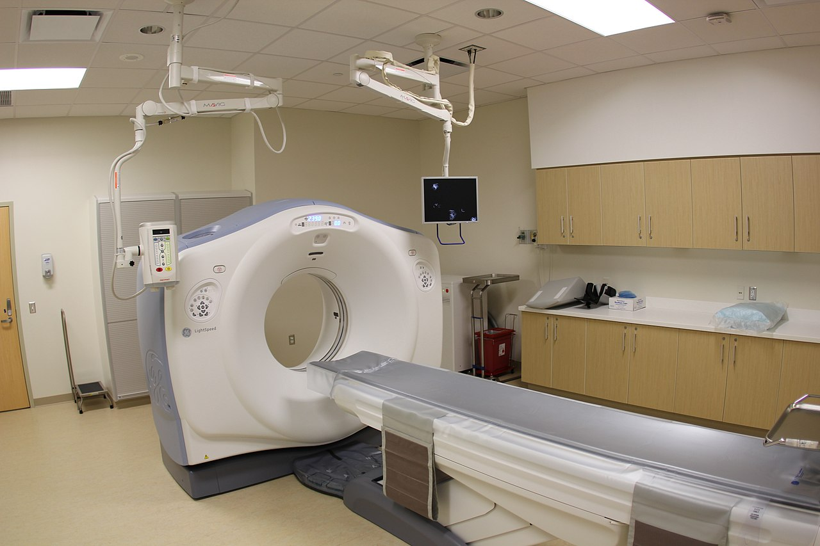
Kompuutertomograafia (computer tomography)
Kompuutertomograafia kombineerib paljude nurkade alt tehtud röntgenpildid üheks ruumiliseks pildiks
Notes:
https://et.wikipedia.org/wiki/Kompuutertomograaf#/media/Fail:UPMCEast_CTscan.jpg

Slide 29
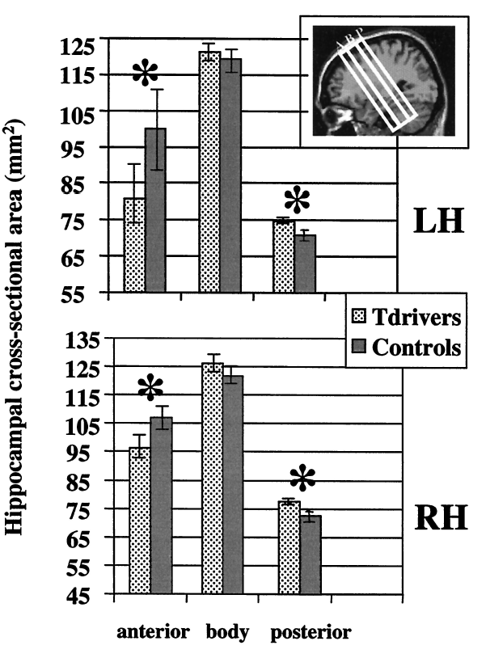
Strukturaalsed erinevused
(Maguire et al., 2000)
Notes:
Maguire, E. A., Gadian, D. G., Johnsrude, I. S., Good, C. D., Ashburner, J., Frackowiak, R. S., & Frith, C. D. (2000). Navigation-related structural change in the hippocampi of taxi drivers. Proceedings of the National Academy of Sciences, 97(8), 4398-4403.
Fig. 2. Volumetric analysis findings. The orientation of the slices measured in the volumetric analysis with respect to the hippocampus is shown (Top Right Inset).
A, anterior; B, body; P, posterior. (Upper) The mean of the cross-sectional area measurements (uncorrected for ICV) for the three regions of the left hippocampus
(LH). (Lower) The means for the right hippocampus (RH). Taxi drivers had a significantly greater volume relative to controls in the posterior hippocampus, and
controls showed greater hippocampal volume in the anterior. There was no difference between the two groups in the hippocampus body. *, P , 0.05.

Slide 30


Slide 31


Slide 32
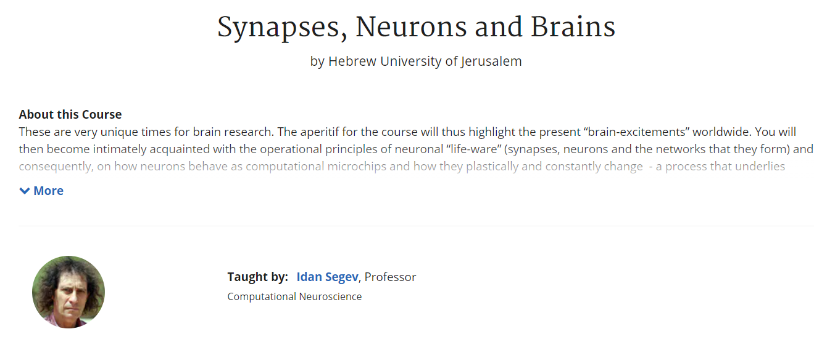

Slide 33
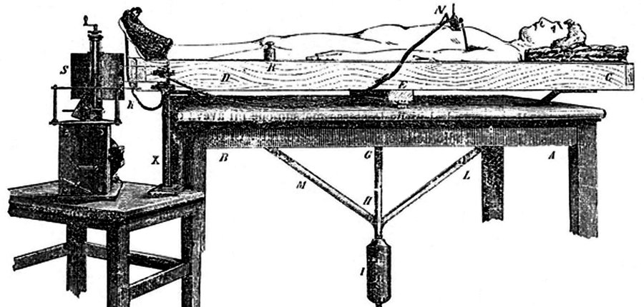
Angelo Mosso (1846 –1910)
1882
Notes:
https://www.npr.org/2014/08/17/340906546/the-machine-that-tried-to-scan-the-brain-in-1882

Slide 34
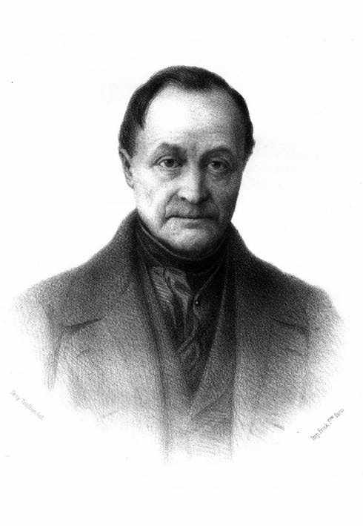

Auguste Comte (1798-1857)
(Mee, 2012)
Notes:
https://blacksmithu.com/how-blacksmiths-measure-temperature/
Mee, N. (2012). Higgs Force: Cosmic Symmetry Shattered: the Story of the Greatest Scientific Discovery for 50 Years. Quantum Wave Publishing. (vt pt 3)

Slide 35
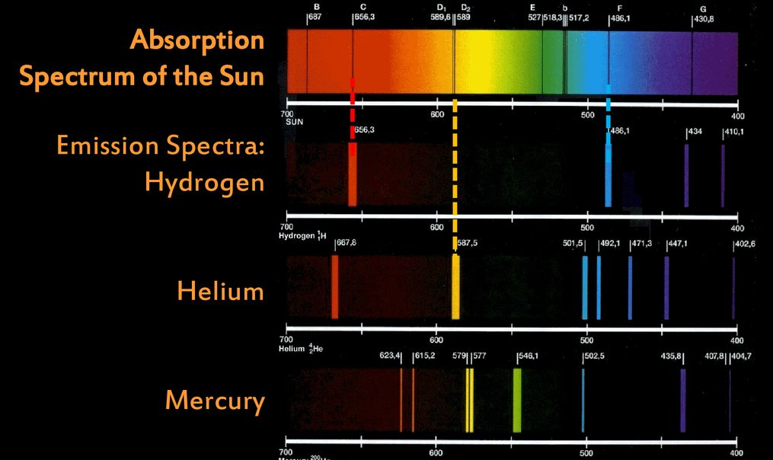
Auguste Comte (1798-1857)
(Mee, 2012)
Notes:
https://www.youtube.com/watch?v=1uPyq63aRvg
https://www.extremetech.com/extreme/167878-every-color-of-the-suns-rainbow-why-are-there-so-many-missing
Mee, N. (2012). Higgs Force: Cosmic Symmetry Shattered: the Story of the Greatest Scientific Discovery for 50 Years. Quantum Wave Publishing. (vt pt 3)

Slide 36
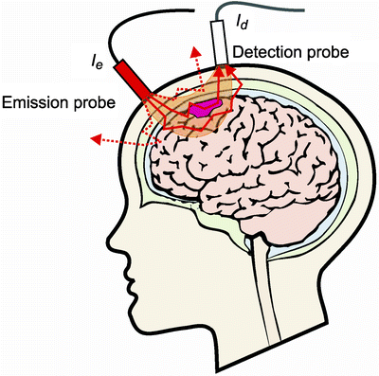
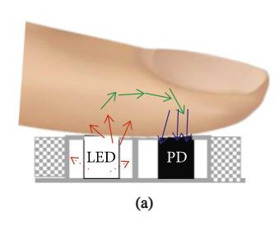
fNIRS ehk fotopletüsmograaf steroididel
fNIRS – funktsionaalne lähiinfrapuna spektroskoopia
(Baek, Shin, & Cho, 2018)
(Okada, E2013)
Notes:
https://et.wikipedia.org/wiki/Kompuutertomograaf#/media/Fail:UPMCEast_CTscan.jpg
Pletüsmograafia (kreeka keeles. Plethysmos - täitmine, suurendamine ja graafiline salvestamine) - perifeerse organi või kehaosa (jäseme, sõrme, ahtri jms) mahu muutuste pidev graafiline salvestamine, et määrata kindlaks testorgani verevarustuse kõikumised.
Baek, H. J., Shin, J., & Cho, J. (2018). The effect of optical crosstalk on accuracy of reflectance-type pulse oximeter for mobile healthcare. Journal of healthcare engineering, 2018.
Okada, E. (2013). Photon Migration in NIRS Brain Imaging. In Application of Near Infrared Spectroscopy in Biomedicine (pp. 37-58). Springer, Boston, MA.

Slide 37
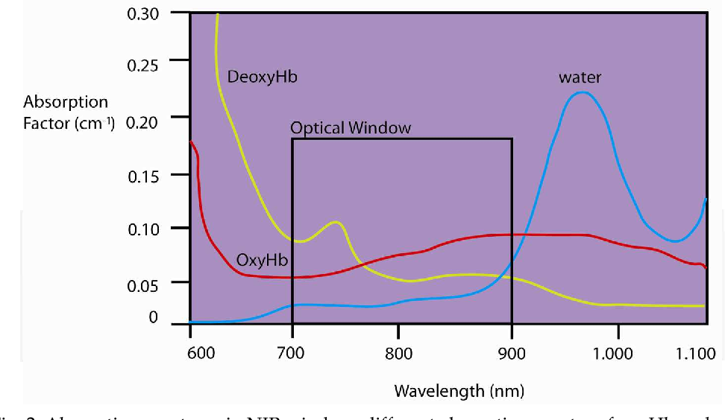
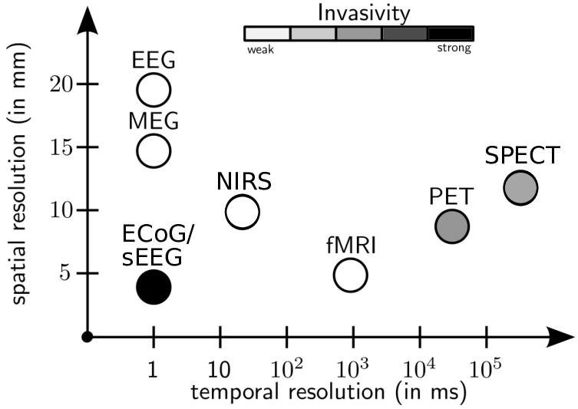
(Hitziger, 2015)
(León-Carrión, & León-Domínguez, 2012)
Notes:
Hitziger, S. (2015). Modeling the variability of electrical activity in the brain (Doctoral dissertation, Université Nice Sophia Antipolis).
León-Carrión, J., & León-Domínguez, U. (2012). Functional near-infrared spectroscopy (fNIRS): principles and neuroscientific applications. Neuroimaging methods, 48-74.

Slide 38
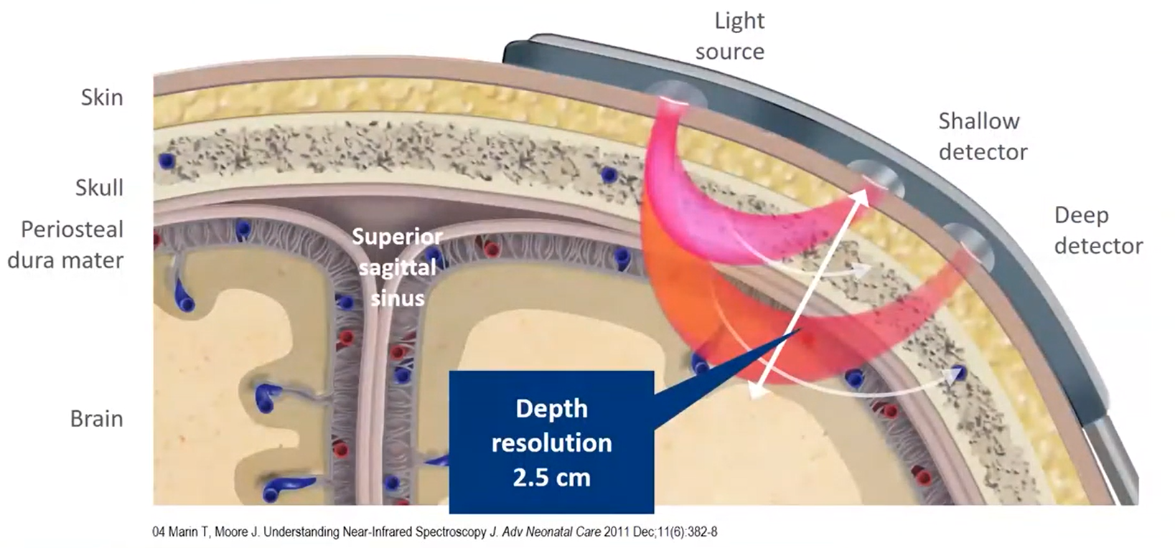
(Marin, & Moore, 2011)
Notes:
Marin, T., & Moore, J. (2011). Understanding near-infrared spectroscopy. Advances in Neonatal Care, 11(6), 382-388.

Slide 39
fNIRS ehk fotopletüsmograaf steroididel
 | fNIRS | fMRI | EEG
Ajaline lahutusvõime | keskmine | madal | kõrge
Ruumiline lahutusvõime | keskmine | kõrge | madal
Mobiilsus | kõrge mobiilsusega | väga madal | kõrge mobiilsus
Elektroonikaseadmetest tingitud artefaktid | jah | ei | jah
Esimene mõõtmine | 90-ndatel | 90-ndatel | 1920-ndatel

Slide 40
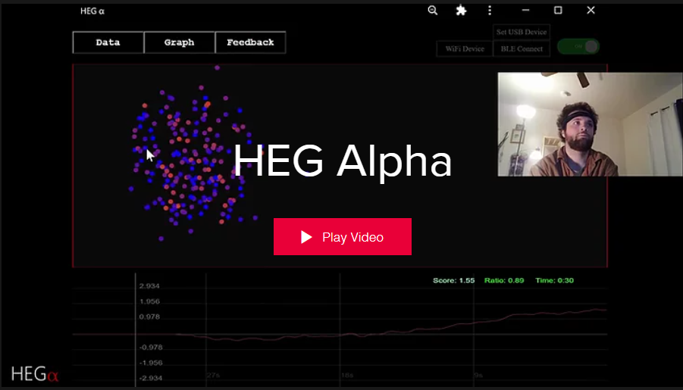

Slide 41
Kasutatud kirjandus (esinemise järjekorras)
Anderson, C. A., Lazard, D. S., & Hartley, D. E. (2017). Plasticity in bilateral superior temporal cortex: Effects of deafness and cochlear implantation on auditory and visual speech processing. Hearing research, 343, 138-149.
Legner, C., Kalwa, U., Patel, V., Chesmore, A., & Pandey, S. (2019). Sweat sensing in the smart wearables era: Towards integrative, multifunctional and body-compliant perspiration analysis. Sensors and Actuators A: Physical, 296, 200-221.
Boucsein, W. (2012). Electrodermal activity. Springer Science & Business Media.
Gleitman, H., Reisberg, D., & Gross, J. (2014). Psühholoogia. Hermes.
Hu, Y., Converse, C., Lyons, M. C., & Hsu, W. H. (2018). Neural control of sweat secretion: a review. British Journal of Dermatology, 178(6), 1246-1256.
Cacioppo, J. T., Tassinary, L. G., & Berntson, G. (Eds.). (2007). Handbook of psychophysiology. Cambridge university press.
Picard, R. W., Fedor, S., & Ayzenberg, Y. (2016). Multiple arousal theory and daily-life electrodermal activity asymmetry. Emotion Review, 8(1), 62-75. Chicago
Mangina, C. A., & Beuzeron-Mangina, J. H. (1996). Direct electrical stimulation of specific human brain structures and bilateral electrodermal activity. International Journal of Psychophysiology, 22(1-2), 1-8.

Slide 42
Kasutatud kirjandus (esinemise järjekorras)
Regalia, G., Onorati, F., Lai, M., Caborni, C., & Picard, R. W. (2019). Multimodal wrist-worn devices for seizure detection and advancing research: focus on the Empatica wristbands. Epilepsy research, 153, 79-82.
Castro, A., & Sergeant, M. (2010). The human nervous system: functional anatomy. In P. BanyardM. N. Davies, & C. Norman (Eds.), Essential psychology: A concise introduction (pp. 129-149). SAGE Publications Ltd, https://www.doi.org/10.4135/9781446251461.n7
Maguire, E. A., Gadian, D. G., Johnsrude, I. S., Good, C. D., Ashburner, J., Frackowiak, R. S., & Frith, C. D. (2000). Navigation-related structural change in the hippocampi of taxi drivers. Proceedings of the National Academy of Sciences, 97(8), 4398-4403.
Mee, N. (2012). Higgs Force: Cosmic Symmetry Shattered: the Story of the Greatest Scientific Discovery for 50 Years. Quantum Wave Publishing. (vt pt 3)
Okada, E. (2013). Photon Migration in NIRS Brain Imaging. In Application of Near Infrared Spectroscopy in Biomedicine (pp. 37-58). Springer, Boston, MA.
Hitziger, S. (2015). Modeling the variability of electrical activity in the brain (Doctoral dissertation, Université Nice Sophia Antipolis).
León-Carrión, J., & León-Domínguez, U. (2012). Functional near-infrared spectroscopy (fNIRS): principles and neuroscientific applications. Neuroimaging methods, 48-74.
Marin, T., & Moore, J. (2011). Understanding near-infrared spectroscopy. Advances in Neonatal Care, 11(6), 382-388.

Slide 43
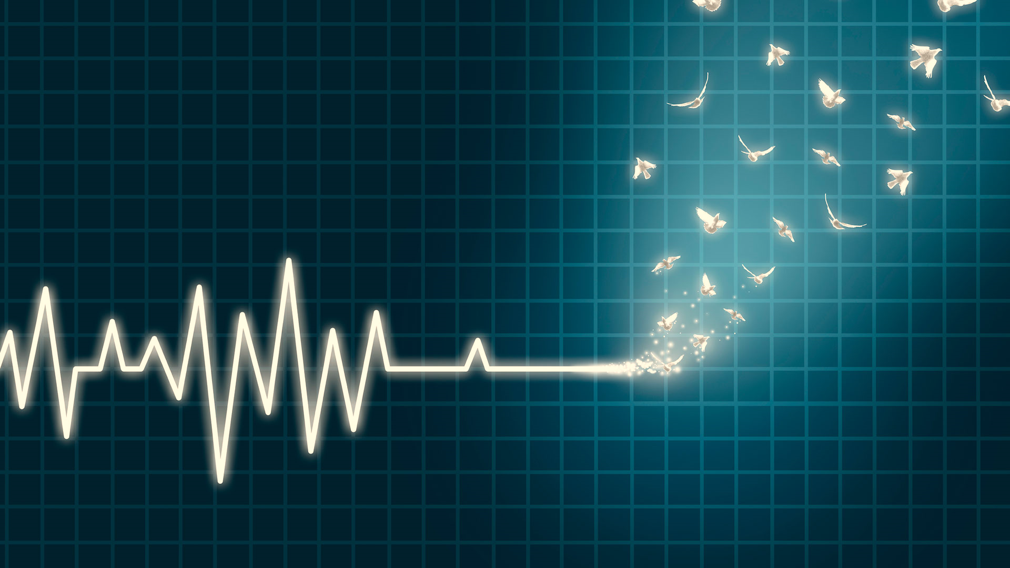
Aitäh!
Küsimused?
Notes:
https://www.vision.org/sites/default/files/img/1999_is-it-the-end-of-everything_1920x1080.jpg

Slide 45
Sissejuhatus psühhofüsioloogia rakendustesse
Intervjuu
HEG Alpha asutaja
Joshua Brewster
Kursuse arendamist toetas Haridus- ja noorteameti IT-akadeemia
Notes:
https://www.hegalpha.com/

